Slide 1

Online, Secure, Advance Care Planning Program in English & Spanish
for Your Care
Notes:
PREPARE for Your Care is an online, secure advance care planning program in English and Spanish. Several of our materials, including our easy-to-read, evidenced-based, legally valid advance directives, are in over 10 languages.

Slide 2
The PREPARE Team
UCSF: Rebecca Sudore, MD, Jana Powell, Clarissa Ferguson, Brookelle Li
UC Law: Sarah Hooper, JD, Denise Watt, JD
People Designs: David Farrell, MPH
Community Advisory Board: Patients, Caregivers and experts in aging, ethics, health literacy, communication, behavior change
https://prepareforyourcare.org/en/story
Notes:
Leading healthcare experts and the Centers for Medicare and Medicaid agree on the need for advance care planning.
This is becoming increasingly important to health systems as the population is aging, the burden of chronic illness is increasing, and people are not prepared for medical decision making.
Advance care planning (ACP) is an important quality metric. It prepares patients and surrogate decision makers (sometimes called proxies or someone’s medical advocate) for medical decision making.
It has also been shown to improve patients’ and surrogates’ satisfaction with communication and medical care
And, importantly, has been shown in several randomized trials to decrease surrogate burden, post traumatic stress disorder, and complicated grief

Slide 3

Need for Advance Care Planning
Populations are aging, the burden of chronic illness is increasing, people are not prepared for decision making
Advance care planning (ACP) is an important quality metric
  It prepares patients & surrogates for medical decision making
  Improves satisfaction with communication and care
  Decreases surrogate burden, PTSD, complicated grief
McMahan, Sudore et al. J Am Geriatr Soc. 2020
https://www.cms.gov/outreach-and-education/medicare-learning-network-mln/mlnproducts/downloads/advancecareplanning.pdf
Notes:
Leading healthcare experts and the Centers for Medicare and Medicaid agree on the need for advance care planning.
This is becoming increasingly important to health systems as the population is aging, the burden of chronic illness is increasing, and people are not prepared for medical decision making.
Advance care planning (ACP) is an important quality metric. It prepares patients and surrogate decision makers (sometimes called proxies or someone’s medical advocate) for medical decision making.
It has also been shown to improve patients’ and surrogates’ satisfaction with communication and medical care
And, importantly, has been shown in several randomized trials to decrease surrogate burden, post traumatic stress disorder, and complicated grief

Slide 4

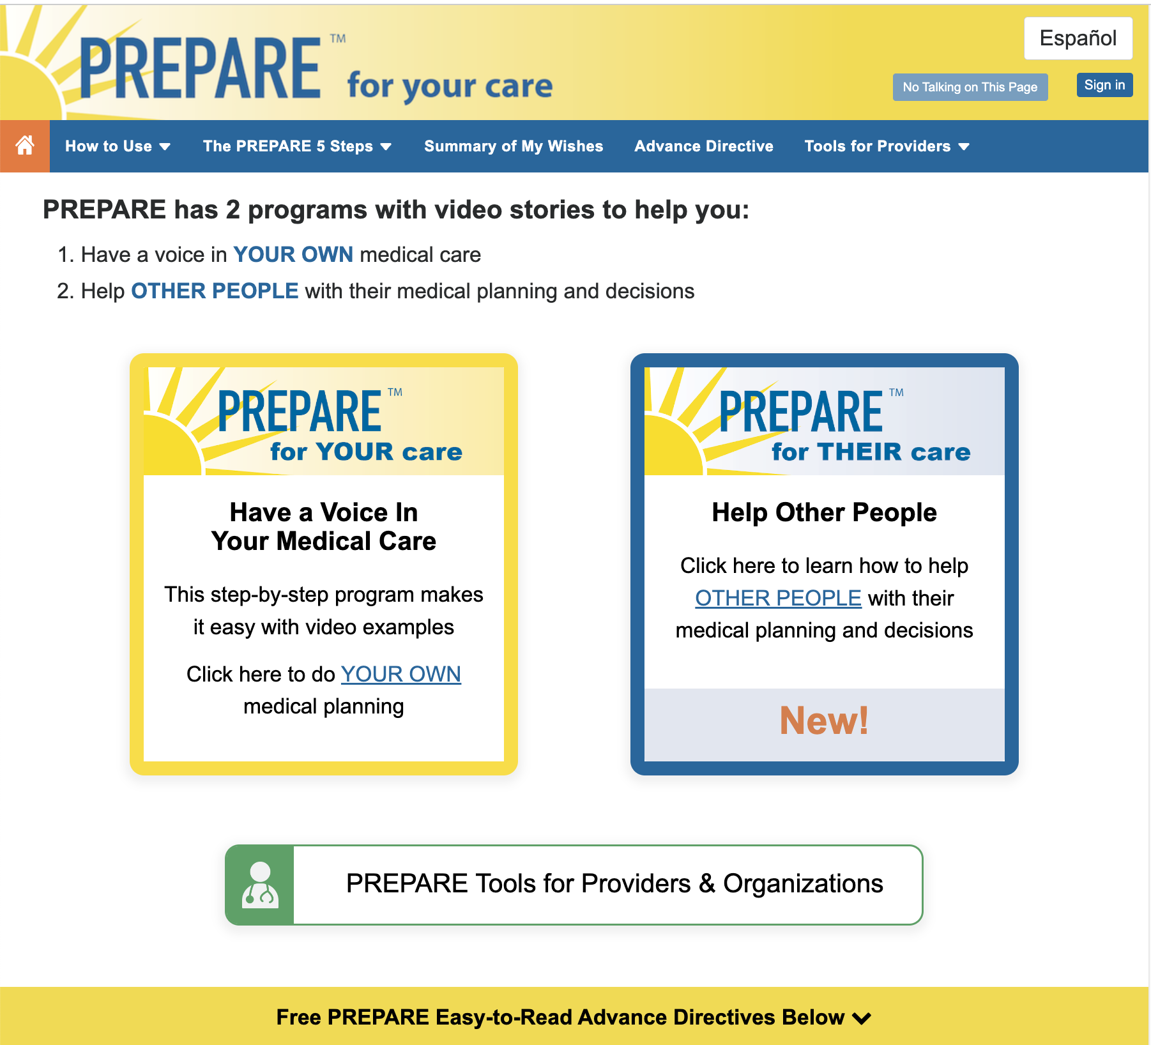
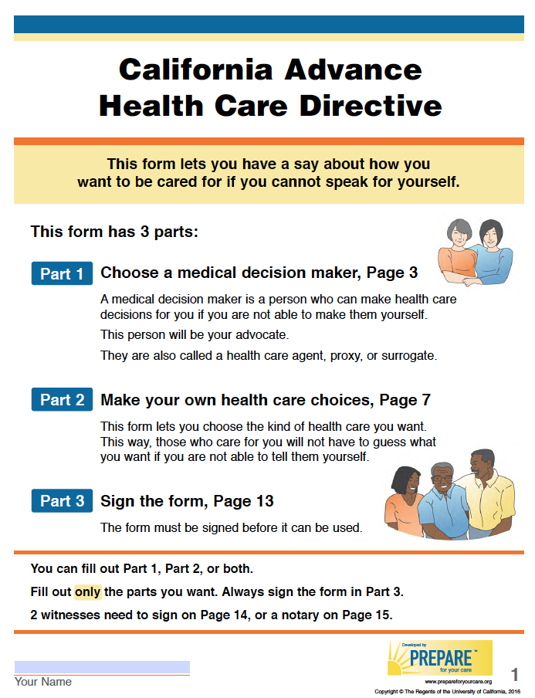
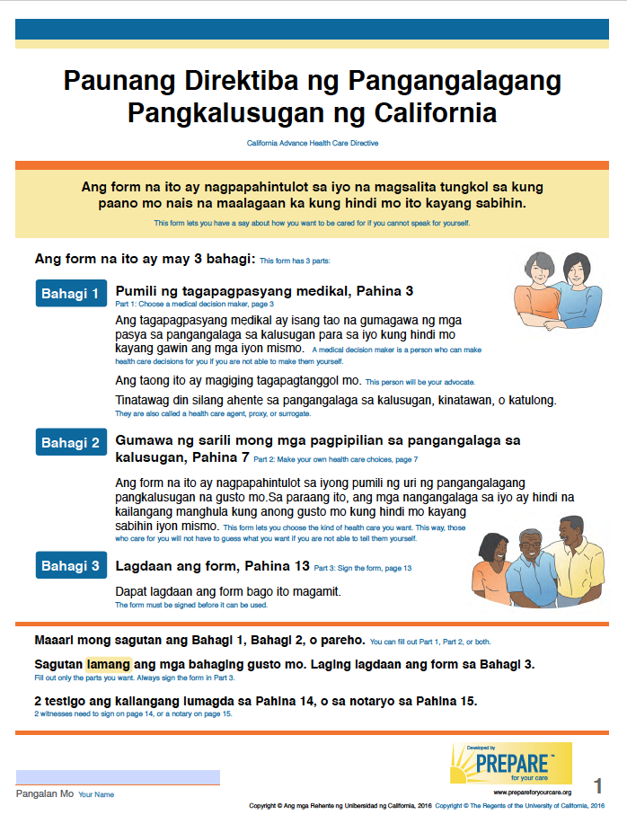
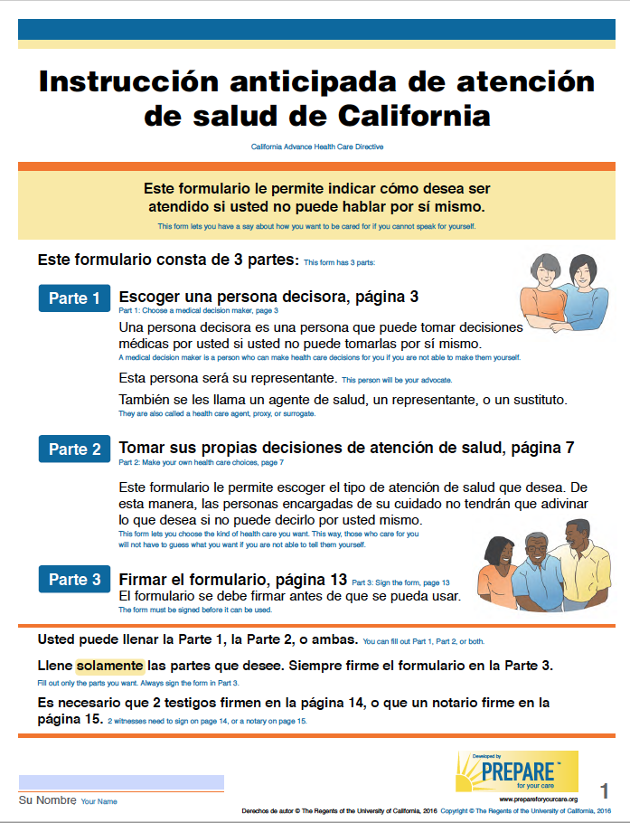
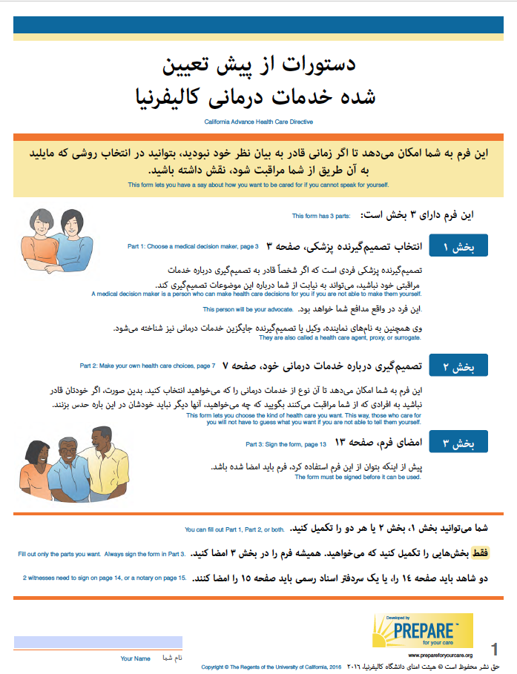
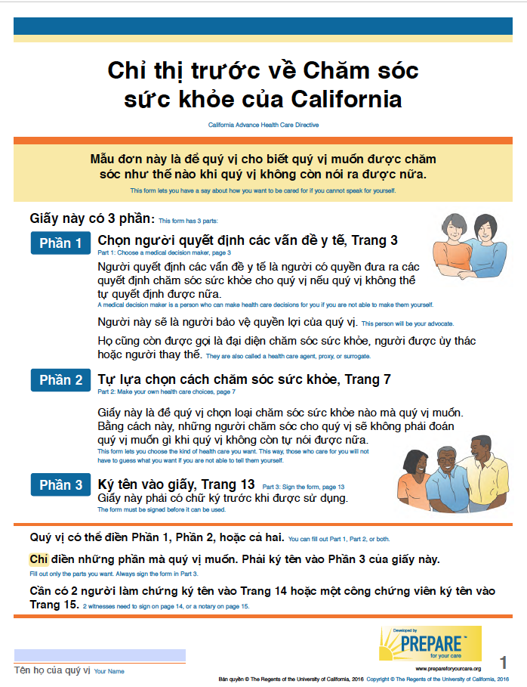
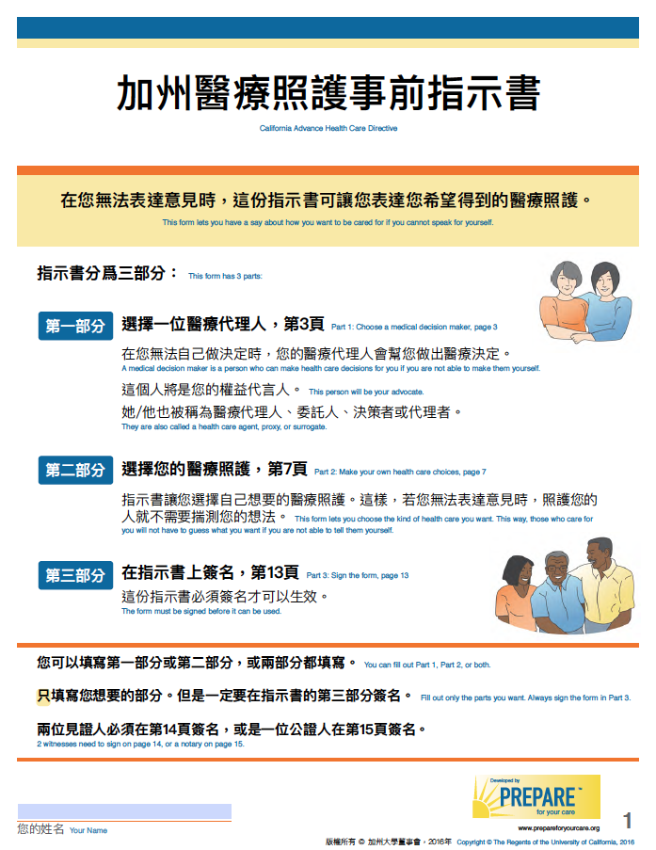
Online, Secure ACP Program with Videos
and Easy-to-Read Advance Directives
https://www.ncoa.org/article/evidence-based-program-prepare-for-your-care
Notes:
PREPARE for their Care is an interactive, online, and secure program designed to meet the advance care planning needs of diverse populations.
PREPARE uses video stories and easy-to-read advance directives to help people make medical decisions based on their values and preferences and prepare them and their family and friends for medical decision making.
It is also the only patient-directed ACP program that has been designated as an Evidence Based Program by the National Council on Aging through the US Administration for Community Living

Slide 5
Co-Developed with Patients, Caregivers, and Communities
Literacy, Language, Culture
Sudore et al. JAMA Intern Med. 2018; Scheerens, Sudore et al. J Am Geriatr Soc. 2021
Notes:
PREPARE was co-developed with patients, caregivers, and ethnically, culturally, and linguistically diverse communities. We take health literacy and language into consideration to make sure our materials are easy to read. We also take culture into consideration, which may include non-Western views on autonomy and decision making.

Slide 6
Based on Decades of Research
Notes:
PREPARE is also based on decades of research and proven outcomes.

Slide 7
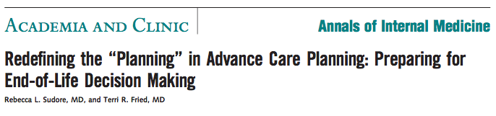



Based on New and Improved ACP Models
NEW & IMPROVED
Life sustaining
treatments
Life
sustaining treatments
Preparation for communication & medical decision making
Ann Intern Med. 2010 Aug
Life
sustaining
treatments
Preparation for communication & medical decision making
Notes:
For example, the PREPARE team has helped to move the field of advance care planning forward.
Our team published an article in the Annals of Internal in 2010 calling for the Redefining of the Planning in Advance Care planning to not only ask about preferences for life sustaining treatment, but to also prepare patients and their surrogate decision makers for communication and medical decision making.
As the field of advance care planning has evolved away from only measuring and supporting one-time check boxes for code status, such as do not resuscitate, PREPARE for Your Care has operationalized this new and improved model of advance care planning by focusing on preparing people and their family and friends for communication and medical decision making.

Slide 8





PREPARE Fills a Missing Puzzle Piece
PREPAREs people with skills to:
  Identify what is most important and how they want to live
  Talk with family, friends, medical providers
  Make informed decisions
  Get the care that is right for them
What about this icon instead?
Sudore RL. & Fried TR. Ann Intern Med, 2010
Notes:
PREPARE fills a Missing Puzzle Piece in ACP in that it PREPAREs people with skills:
-To identify what is most important to them and how they want to live
-To talk with family, friends, and medical providers
-To make informed medical decisions
-And to get the care that is right for them.

Slide 9
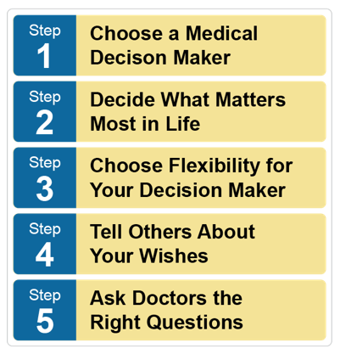
Walks People Through Step by Step
  PrepareForYourCare.org
Notes:
PREPARE walks people through advance care planning step-by-step in it’s 5-step program.

Slide 10

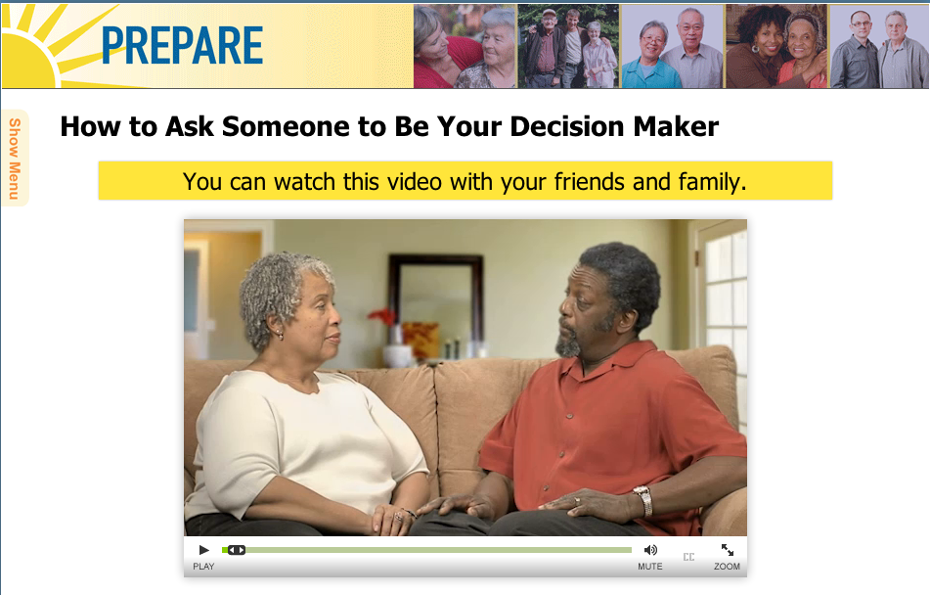
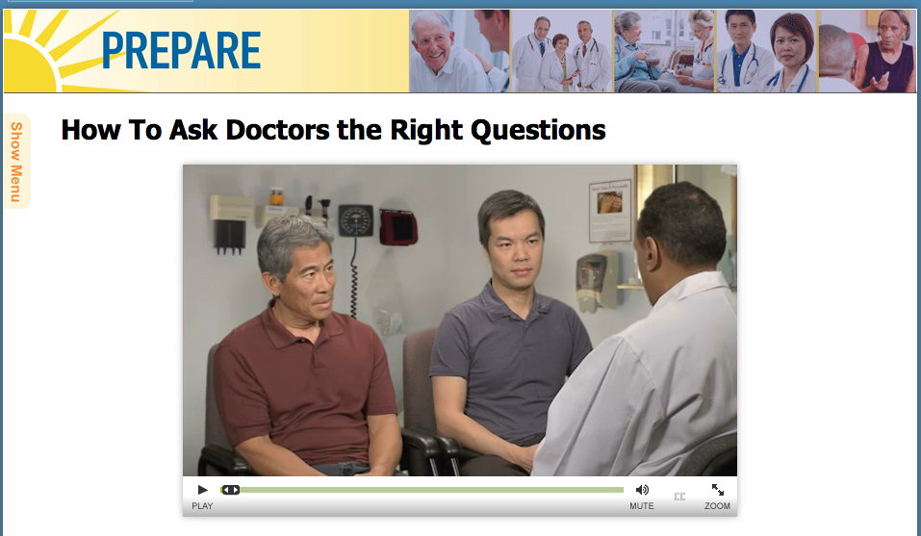
Shows “How to” Videos
5th grade reading level
Narration & closed captioning
Sudore, et al. JAGS 2021. https://pubmed.ncbi.nlm.nih.gov/34081773/
Notes:
In addition, PREPARE doesn’t just tell people to do something, but by using behavior change theory, the program models and shows people how to do advance care planning through How To Videos, such as “How to Ask Someone to Be Your Medical Decision Maker”, “How to Ask Doctors the Right Questions,” ”How to Talk to Your Family and Friends, etc. All of these videos were co-created with our community partners.
The program is also written at a 5th grade reading level, has voice over narration to address limited literacy, and closed captioning to address hearing impairment. These features were included to ensure universal access and to decrease disparities in accessing ACP information.

Slide 11

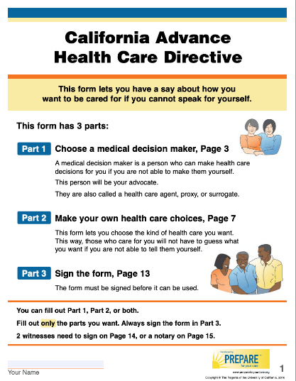
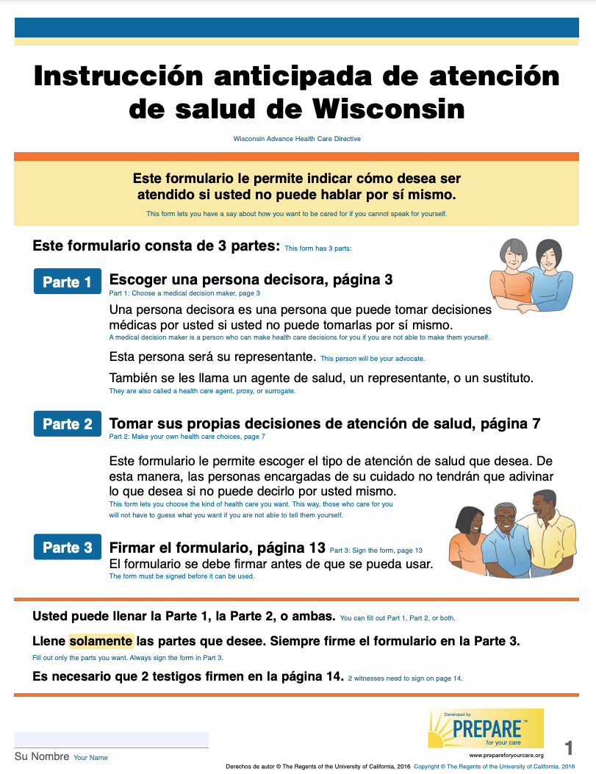
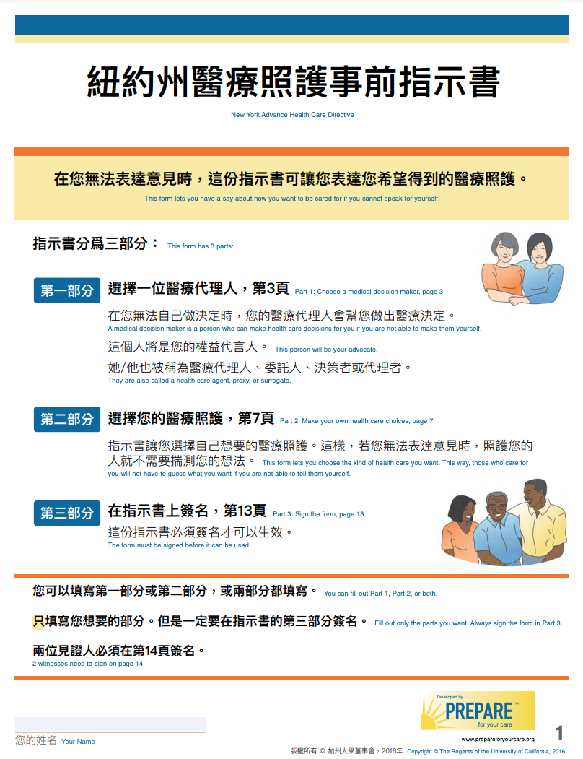
Integrates Easy-to-read Legal ADs for all US states in English & Spanish and 13+ in Chinese
Notes:
PREPARE also integrates easy-to-read, legally valid advance directives for all US states in English and Spanish into the PREPARE program.
We also have a growing number of state forms in Chinese and for California the forms have been culturally adapted into 11 different languages.
Our legal team continuously reviews all US state laws on advance directives. Our team makes sure these forms are the most up to date to ensure legal compliance in all languages. In addition, we engage in a rigorous translation and cultural adaptation process for any of our translated documents.
It is important to note that the PREPARE advance directives are very different from standard forms. First, they are targeted to the 5th grade reading level and contain pictures to help explain the text. In addition, the forms include questions about what quality of life means to people and how they want to live, as well as the things that would be important to them if they had a serious illness or were at the end of life, such as their family and friends.

Slide 12
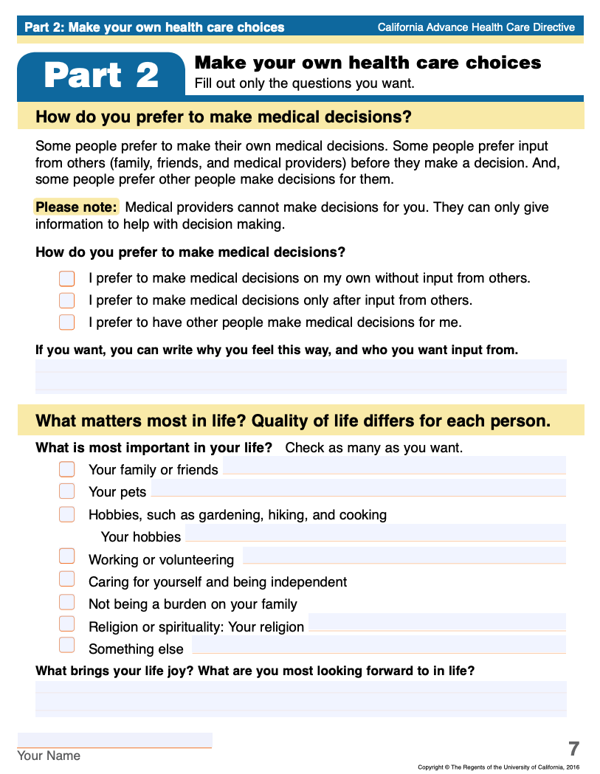
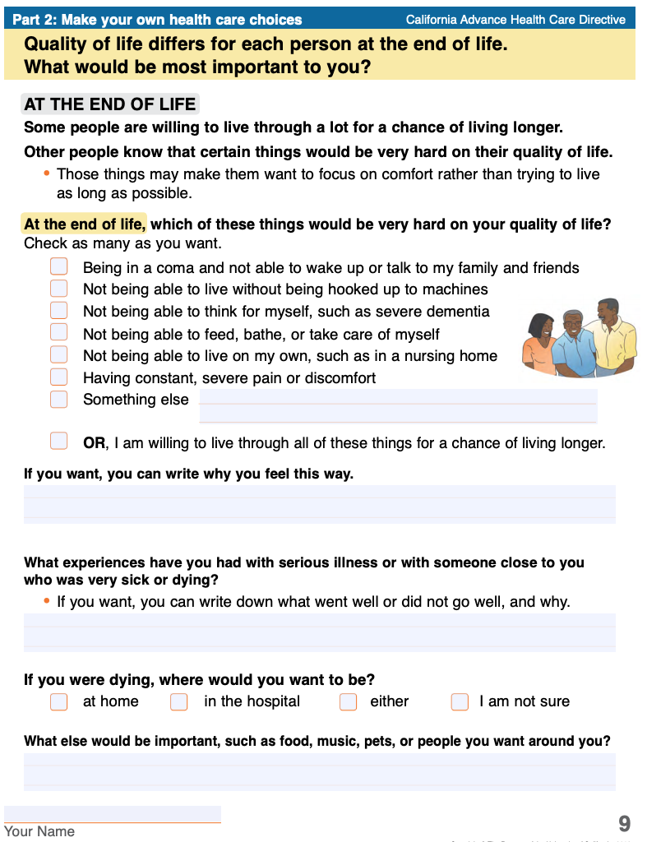
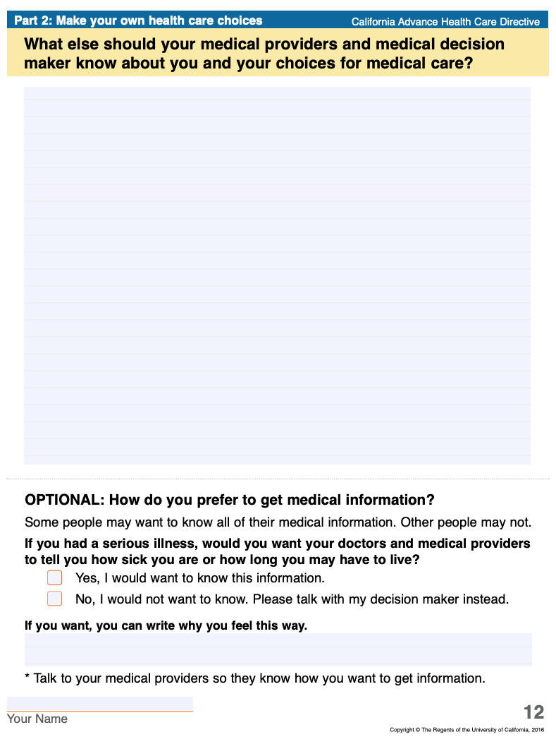
Values & Space to write “Why” & other wishes
Notes:
The forms may look different than standard advance directive forms as they are written at a 5th grade reading level, and include questions about values and quality of life, such as pets and hobbies, as well a space to write “Why” something is important to them.

Slide 13
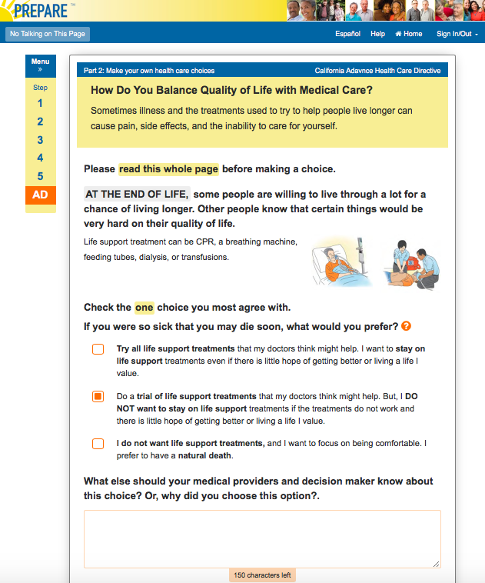
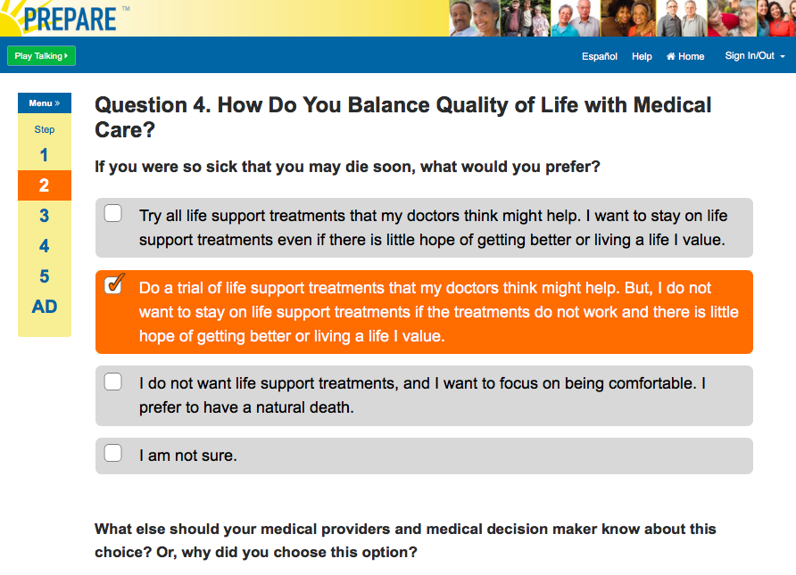
Pre-populates Answers to Legal AD forms
Tailored answer automation
Notes:
As people are going through the 5 steps of PREPARE and answering values questions about their medical care, PREPARE will pre-populate an advance directive for them.

Slide 14
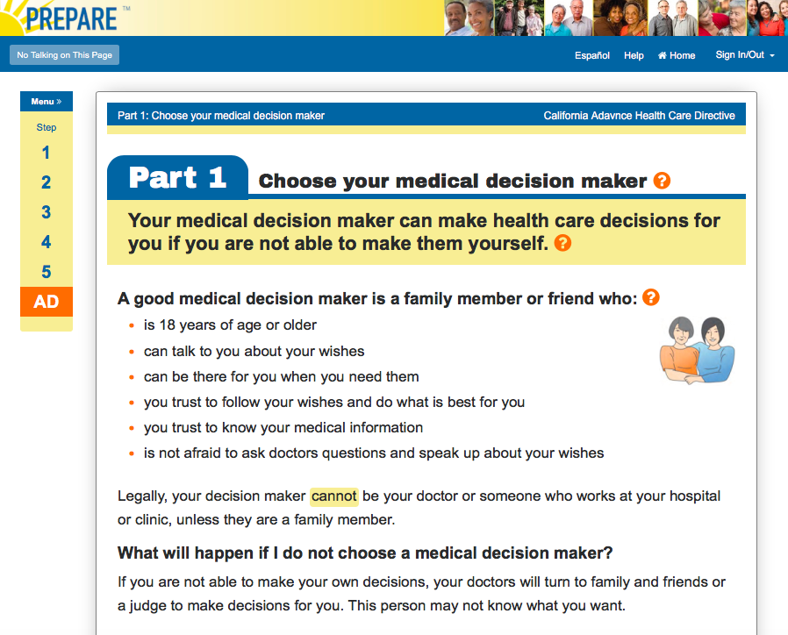
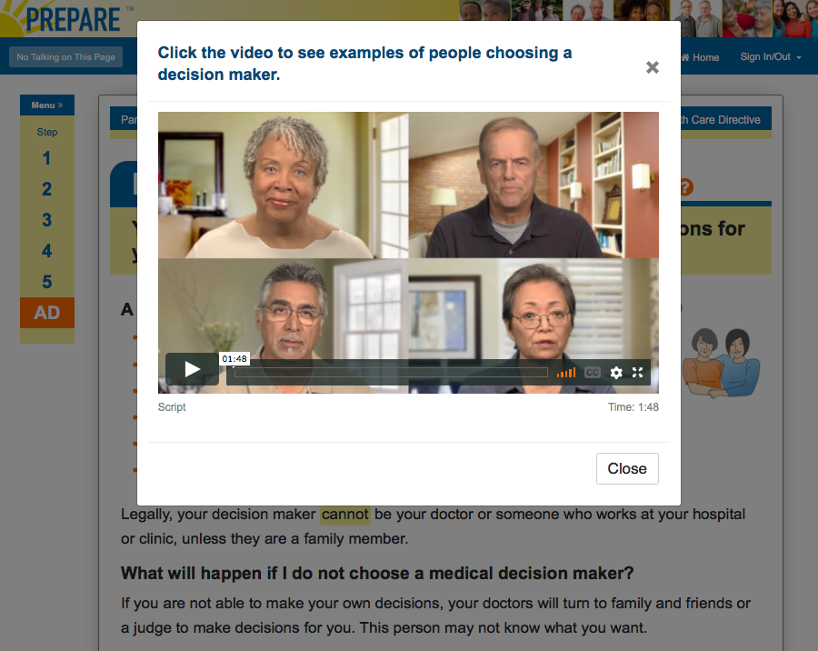
Guides People in AD Completion
Additional information and videos available if needed
Notes:
For people who want to go straight to the form, the PREPARE program also guides people in AD completion.

Slide 15
Makes ACP Easier on Patients & Clinicians
Proven Outcomes in Randomized Trials
Notes:
The PREPARE for Your Care program has been shown to make ACP easier on patients and clinicians.
And, it has proven outcomes demonstrated in randomized trials.

Slide 16
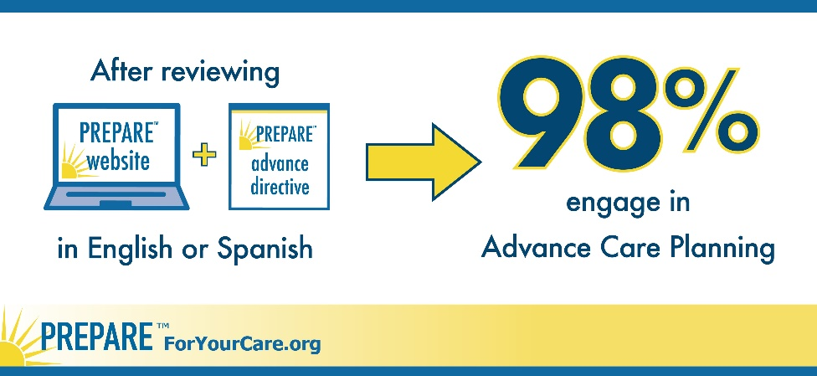
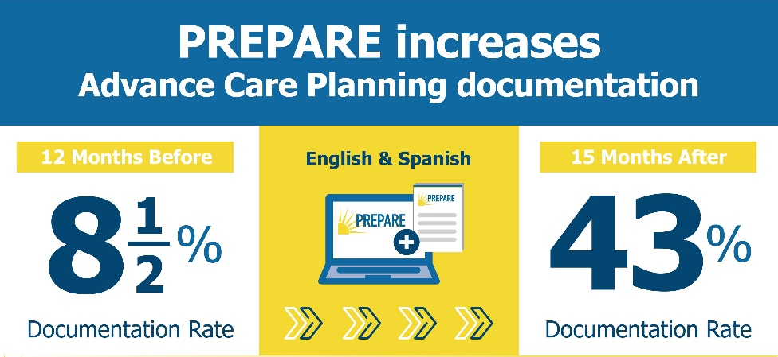

RCTs: 1400 English/Spanish-speaking Older Adults: Patient-facing→Primes Patients, Decreases Disparities
Directly observed visits:
~50% greater patient empowerment, clinician responsiveness
~50% increased real-time goal concordant care: 33% → 59%
Sudore et al. JAMA IM 2017; Sudore et al. JAMA IM 2018; Freytag et al. JAGS 2020; Nouri et al. JAGS 2021; Rennels et al. JAGS 2023
Notes:
In 2 randomized control trials (RCTs) we included over 1400 English and Spanish speaking older adults where one group received the easy-to-read advance directive, and the other group received the advance directive and PREPARE.
This trial included no clinician or health system intervention as we wanted to know the efficacy of a purely patient-facing intervention. We found that PREPARE primes patients and decreased disparities in ACP across ethnically and culturally diverse patients. At 1 year, over 98% of patients in the PREPARE arm self-reported engaging in some form of advance care planning. Furthermore, patients were empowered to complete advance directives and bring them into their medical appointment as evidenced by our increase in ACP documentation in the medical record increasing from 8 ½ % to 43% in about 1 year.
Furthermore, we directly observed and audio-recorded over 400 of the subsequent primary care appointments. We found that those patients randomized to the PREPARE arm have 50% greater patient empowerment to bring up ACP on their own during medical visits. And, not surprisingly, primed patients made it easier on clinicians resulting in the clinician in the PREPARE arm having 50% greater responsiveness and ACP documentation in the EHR.
In addition, we found a 50% increase in real-time patient reported goal concordant care, meaning the PREPARE material were helping patients receive the medical care that was right for them.

Slide 17






Decreases Health Disparities
PREPARE, co-created with communities to address:
Outdated models of ACP (i.e., check boxes)
Limited health and digital literacy
Cultural and language diversity
Visual, hearing, cognitive impairment
Sudore et al. JAMA Intern Med. 2018; Scheerens, Sudore et al. J Am Geriatr Soc. 2021
Notes:
PREPARE decreases health disparities through several mechanism, including the fact that it was co-created with culturally diverse communities to address:
-outdated models of ACP that only focus on check box legal forms without also preparing people for communication and medical decision making
-limited health and computer literacy by attention to human factors design elements
-cultural and language diversity by offering our materials in several languages
-And by addressing visual, hearing, and cognitive impairment by using large font, closed captioning, and easy to use, step-by-step materials.

Slide 18
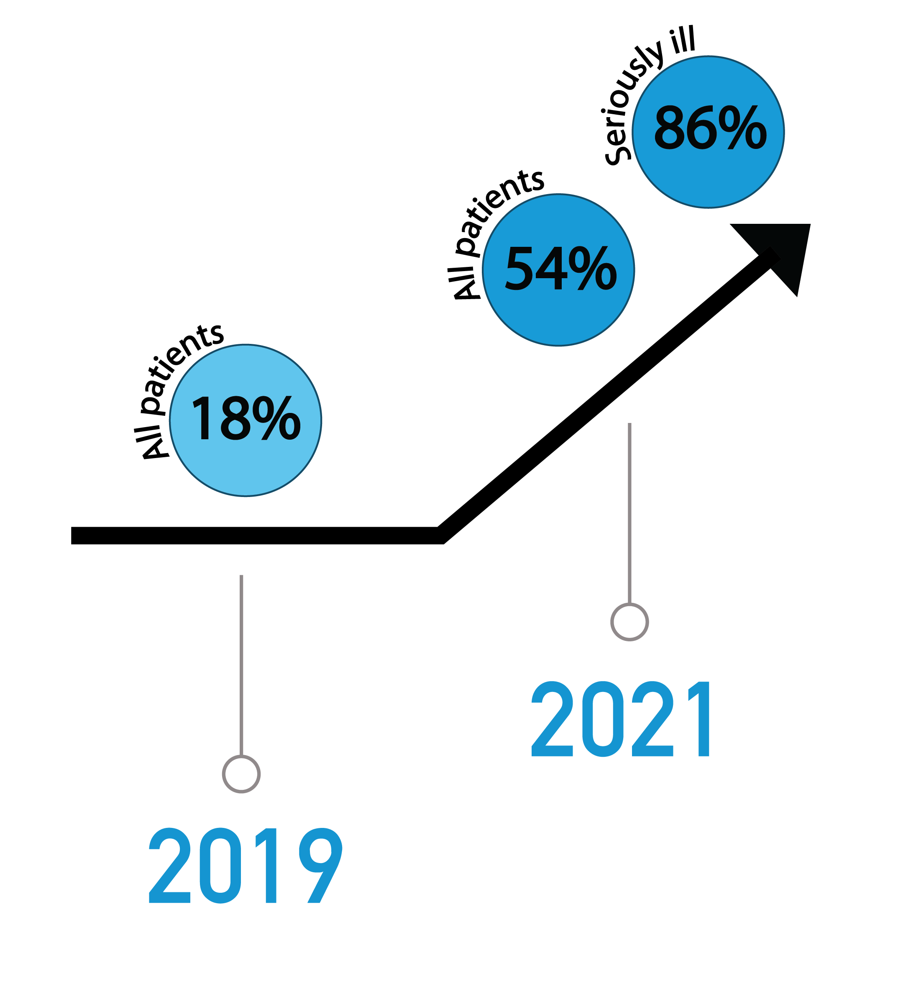
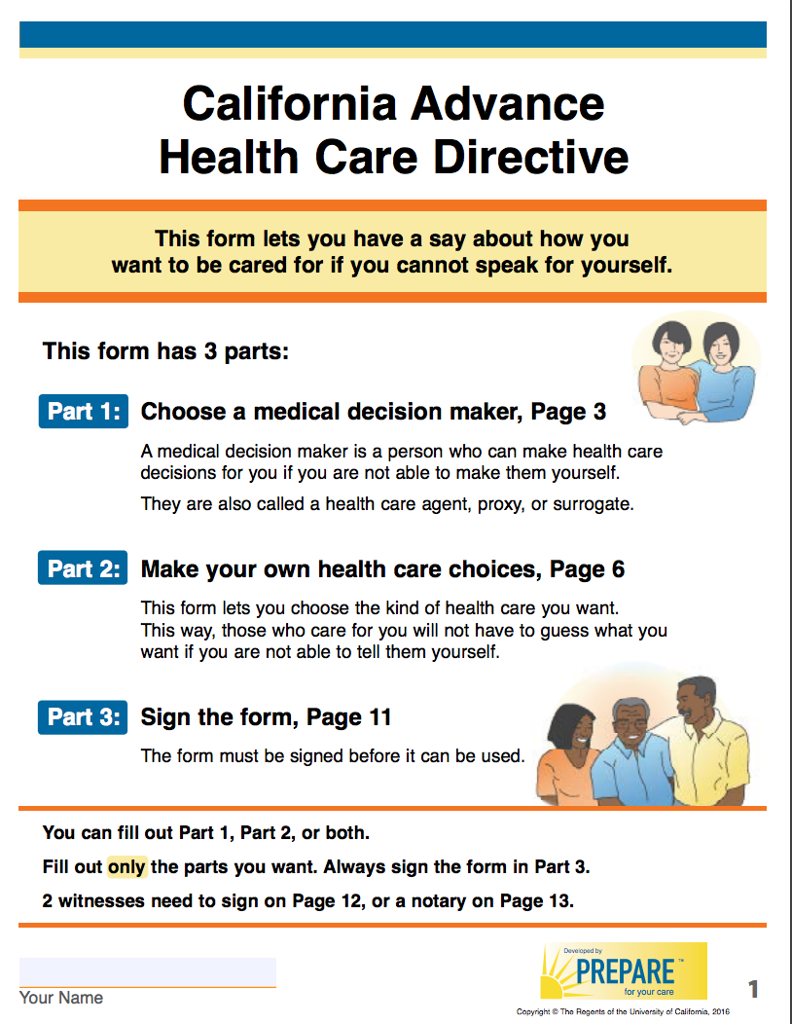
Proven Success in Health Systems
~ 9000 UCSF Primary Care Patients
automated patient portal messages
ACP Documentation
Walling, Sudore, et al. J Palliat Med. 2019. Preliminary, blinded trial findings
Notes:
With PREPARE’s unique design and focus, we have had proven success in health systems. PREPARE has currently been adopted in the University of California and other health systems.
As part of another randomized trial at the University of California, San Francisco including the PREPARE online program and easy-to-read advance directives coupled with automated patient portal messages, we were able to increase the ACP documentation rate for patients in primary care clinics from 18% for in 2019 to 54% in 2021. When we look at just those patients with serious illness, the rate of ACP documentation increased to 86%.

Slide 19
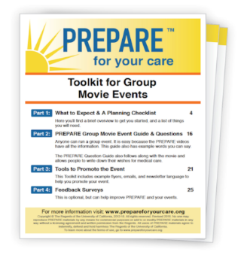
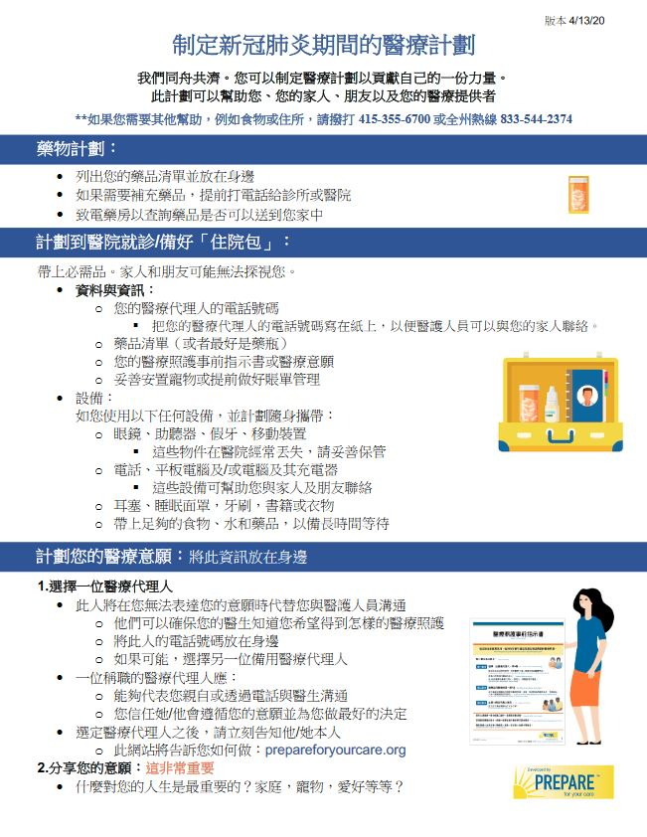
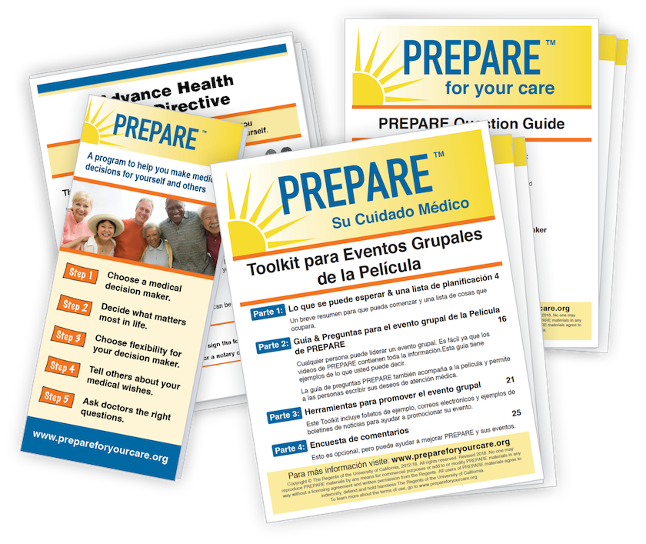
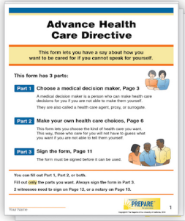

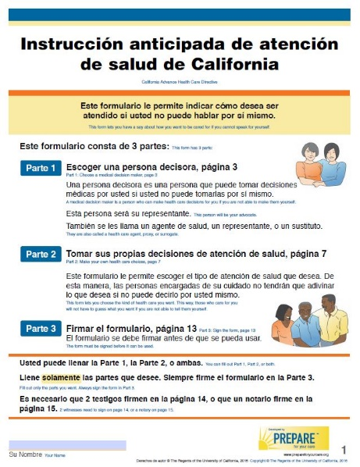
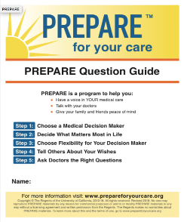

PREPARE Tools for Clinicians
Notes:
In addition to easy-to-use materials for patients, PREPARE also has several tools to make ACP easier for clinicians

Slide 20
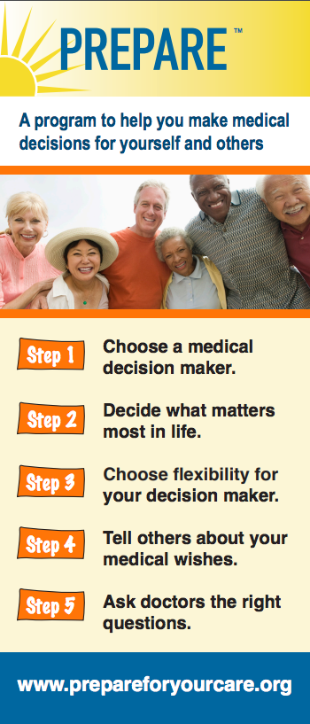

PREPARE Primes Patients
Notes:
Easy-to-read PREPARE pamphlets and advance directives have been shown to decrease health disparities and Prime patients to discuss advance care planning prior to clinic visits, decreasing the burden on clinical staff.

Slide 21
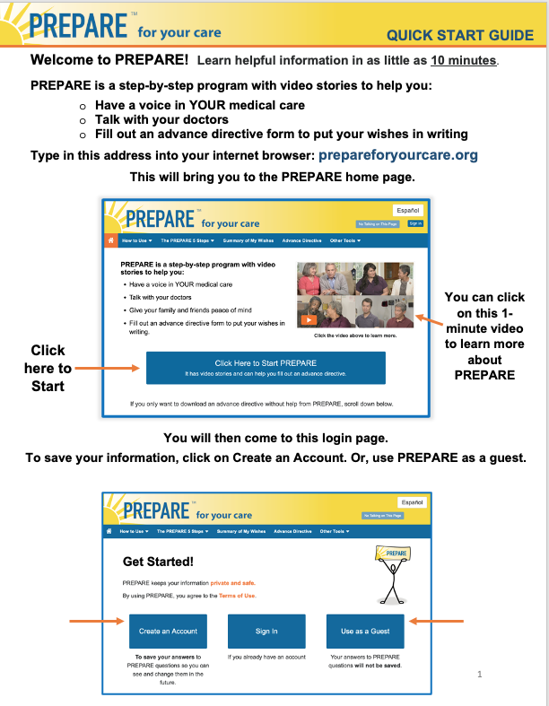
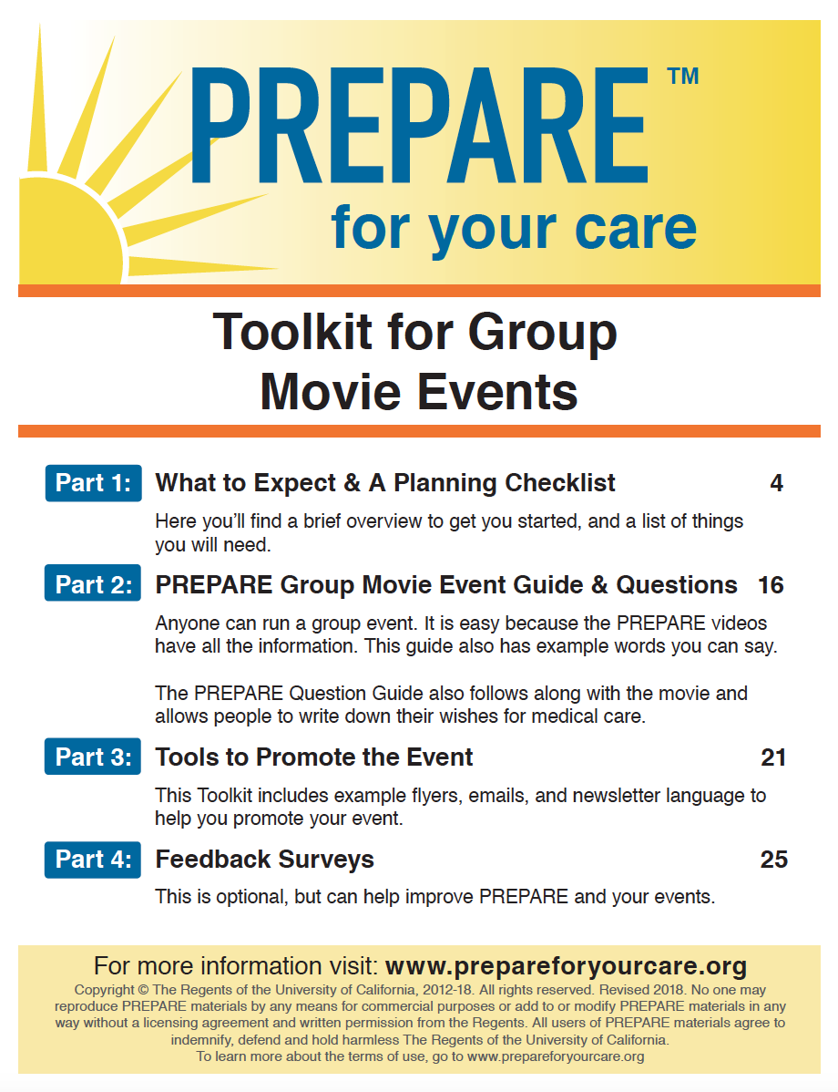
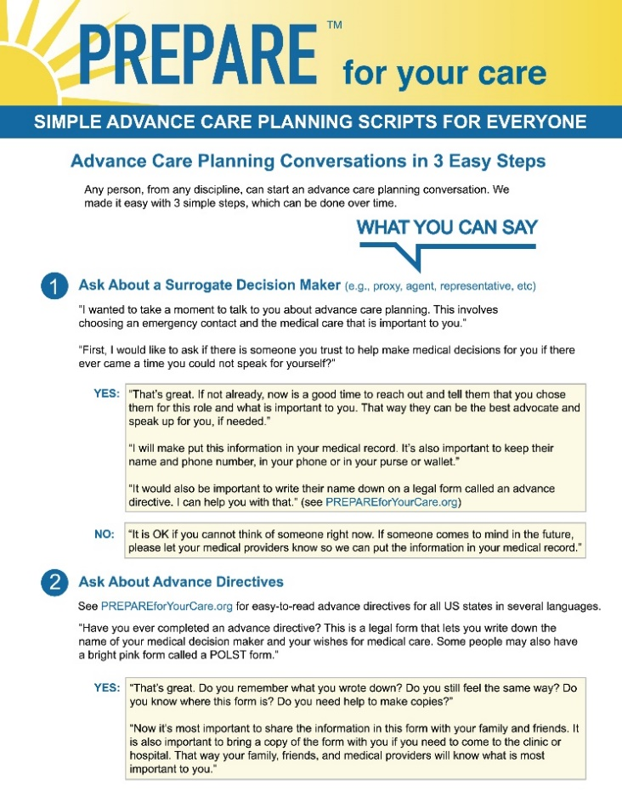
Quick Start Guide for Patients
Group Medical Visit Toolkit
Simple Scripts
Increased ACP documentation 44% to 71%
Increased surrogate designation 75% to 93%
Lum, Sudore J Am Geriatr Soc. 2020;
Block, Sudore, et. al. J Am Geriatr Soc. May, 2020.
Notes:
Materials also include a quick start guide to hand to patients as well as PREPARE pamphlets.
A toolkit to help providers put on and bill for group medical visits. Use of PREPARE in group medical visits has been shown to increase ACP documentation up to 71% and surrogate designation up to 93%.
PREPARE also includes Simple Scripts for clinicians of all backgrounds to make asking about ACP easy during busy clinical encounters easier on clinicians.

Slide 22
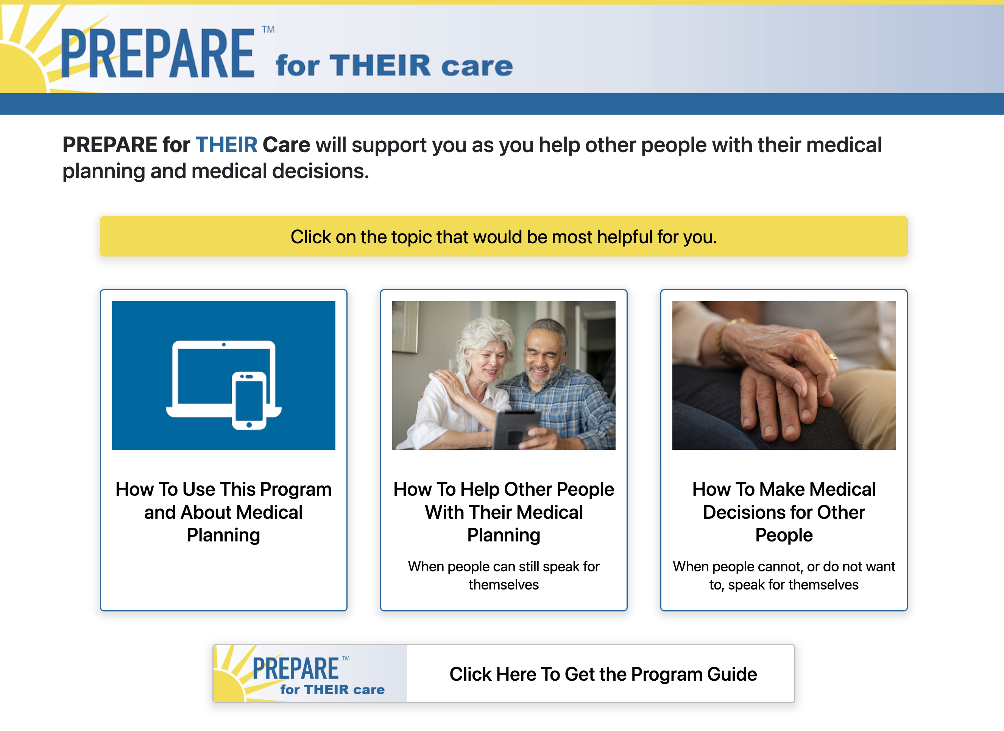
NEW Caregiver Program
Notes:
We are also excited to announce a new caregiver program called PREPARE for THEIR Care. We had been hearing from caregivers for years that they wanted to share PREPARE for Your Care with their family and friends, but they didn’t know how to start those conversations. We have also heard that people need better support when they are in a caregiving role.
Therefore, we obtained funding from the Greenwall Foundation to create this new program that demonstrates:
How to Help Other People with Their Medical Planning
How to Make Medical Decisions for Other People

Slide 23

What Our Partners Are Saying
“It breaks it down into doable actions, instead of walking into a fog of what ACP is all about
~ Patient
“PREPARE is the gold stand of ACP.”
~ Healthcare Leader
“Patients come to their visits prepared, making ACP easier and more efficient.”
~ Clinician
“After seeing examples on the website, deciding on my own wishes is a lot easier for me now.”
~ Patient
Notes:
What our partners are saying: We have received positive feedback from many healthcare leaders, clinicians and patients. Here are just some examples.
“PREPARE is the gold standard of ACP” – notes by a health care leader and health system executive
A clinician reported “Patients come to their visits prepared, making ACP easier and more efficient.”
And patients report that “PREPARE breaks it down into doable actions, instead of walking into a fog of what ACP is all about.” and
“After seeing examples on the website, deciding on my own wishes is a lot easier for me now.”

Slide 24
Summary of the PREPARE Innovation
Evidence-based, NCOA endorsed
Proven outcomes in health systems
Primes patients → easier for clinicians
Accessible & decreases disparities
Customizable
Ongoing legal & content updates
Notes:
In summary
PREPARE is evidenced based and is based on findings from several published randomized trials and is the only patient-facing advance care planning program endorsed by the National Council on Aging.
It has proven outcomes in health systems
It has been shown to prime patients making ACP discussions and documentation easier on clinicians
Great lengths have been made to ensure it is universally accessible in order to decrease disparities in ACP
It is customizable for organizations to change logos or include PREPARE in other programs
And our team provides ongoing legal assessment and provides content updates to ensure all advance directives are in legal compliance for all states in and in all languages.

Slide 25

Licensing Opportunities
The UC Regents offers several licensing opportunities:
Branding of materials and custom landing pages
Data reporting
Research
Third party integration → Powered by PREPARE
Contact info@prepareforyourcare.org and see Terms of use.
Notes:
The UC Regents offers several licensing opportunities including
-custom branding of our materials and custom PREPARE website landing pages
-Data reporting of PREPARE usage
-and Research
In addition, UC regents offers licensing opportunities for integration of PREPARE onto 3rd party platforms in our Powered by PREPARE model.
If you are interested or have additional questions, please contact info@prepareforyourcare.org and visit our Terms of use page.

